Slide 1
CS 4031 Compiler Construction Chapter 10
Faryal Saud
Lecturer, Department of Computer Science
FAST NUCES CFD

Slide 2
Code Generator
The final phase of our compiler model is code generator.
It takes input from the intermediate representation with supplementary information in symbol table of the source program and produces as output an equivalent target program.
Code generator main tasks:
Instruction selection
Register allocation and assignment
Instruction ordering

Slide 3
Code Generator
Code generator is the last phase in the design of a compiler. It takes three address code or DAG representation of the source program as input and produces an equivalent target program as output.
The code generator has many limitations regarding the generation of code that is of high quality, accurate, and efficient. In addition to this, the code generator should run efficiently. There are many issues that are to be considered while designing a code generator.

Slide 4
Code Generator
Instruction selection
choose appropriate target-machine instructions to implement the IR statements
Register allocation and assignment
decide what values to keep in which registers
Instruction ordering
decide in what order to schedule the execution of instruction

Slide 5
Example: Instruction Selection
Intermediate Statement
t1 = a + b
Instruction Selection
ADD EAX, EBX
MOV t1, EAX

Slide 6
Example: Register Allocation
Intermediate Statement
t1 = a + b
Register Allocation
MOV R1, a
MOV R2, b
ADD R1, R2
MOV t1, R1

Slide 7
Example: Instruction Ordering
Intermediate Statement
x = a + b;
y = x * c;
Instruction Ordering
MOV R1, a
MOV R2, b
ADD R1, R2
MOV R3, c
MUL R1, R3

Slide 8
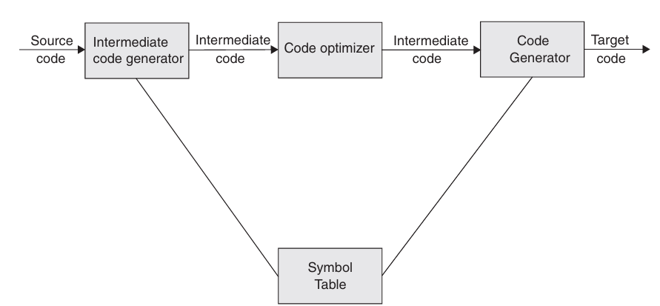
Issues in the Design of a Code Generator

Slide 9
Issues in the Design of a Code Generator
Input to the code generator
Target program
Memory management
Instruction selection
Register allocation
Choice of evaluation order
Approaches to code generation

Slide 10
Input Code Generator
Input to the code generator
IR + Symbol table – IR has several choices
Postfix notation
Syntax tree
Three address code
We assume front end produces low-level IR, i.e. values of names in it can be directly manipulated by the machine instructions.
Syntactic and semantic errors have been already detected

Slide 11
Target Code
The target program
The output of code generator is target program.
Output may take variety of forms
Absolute machine language(executable code)
Relocatable machine language(object files for linker)
Assembly language(facilitates debugging)

Slide 12
Target Code
Absolute machine language has advantage that it can be placed in a fixed location in memory and immediately executed.
Example:
Early microcontroller programming
Programs written in raw binary format for early processors like Intel 8080.
Relocatable machine language program allows subprograms to be compiled separately.
Example:
C and C++ with object files
A .obj file generated from a C program can be linked with other .obj files to form an executable

Slide 13
Target Code
Producing assembly language program as output makes the process of code generation somewhat easier.
Example:
GNU Assembly (GAS) output from compilers
LLVM or GCC producing .s assembly files from C/C++ code before assembling them

Slide 14
Memory Management
Mapping names in the source program to address the data objects on run time memory is done by front end & code generator.
If a machine code is being generated, labels in three address statements have to be converted to addresses of instructions. This process is analogous to “backpatching” technique.

Slide 15
Target Machine
Implementing code generation requires thorough understanding of the target machine architecture and its instruction set
Our (hypothetical) machine:
Byte-addressable (word = 4 bytes)
Has n general purpose registers R0, R1, …, Rn-1
Two-address instructions of the form
op source, destination
Op – op-code
Source, destination
data fields

Slide 16
OP Codes
Op-codes Op-codes (op)
Example:
MOV (move content of source to destination)
ADD (add content of source to destination)
SUB (subtract content of source from destination)
There are also other ops 18

Slide 17
Instruction Cost
Machine is a simple processor with fixed instruction costs
In most of the machines and in most of the instructions the time taken to fetch an instruction from memory exceeds the time spent executing the instruction.
So reducing the length of the instruction has an extra benefit.

Slide 18
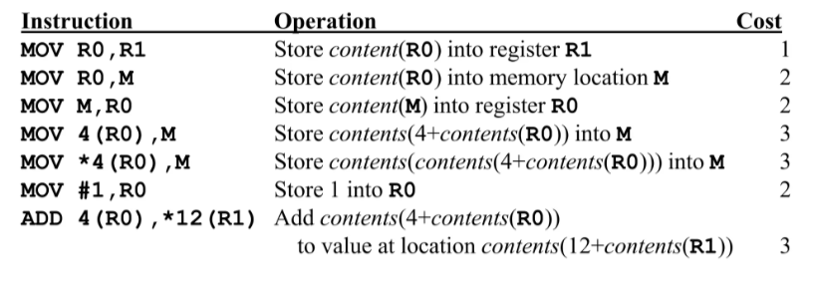
Example
Notes:
Let's go step by step for each instruction from the table and analyze its computing cost based on constant values:
1. MOV R0, R1
Operation: Copy the contents of register R0 into register R1.
Cost: 1
Step-by-Step Execution:
Read value from R0 → Cost = 0
Store value into R1 → Cost = 1
Total Cost = 1
2. MOV R0, M
Operation: Store the contents of register R0 into memory location M.
Cost: 2
Step-by-Step Execution:

Slide 19
Calculate the Cost
Mov R0, R1
Operation: - Copy the contents of register R0 into register R1.
Read value from R0 → Cost = 0
Store value into R1 → Cost = 1
Total Cost = 1
MOV R0, M
Operation: Store the contents of register R0 into memory location M.
Read value from R0 → Cost = 0
Find memory location M → Cost = 1
Store value into M → Cost = 1
Total Cost = 2

Slide 20
Running Procedure
llvm-as name_file_LLVM –o OutputfileName
llc OutputfileName -filetype=obj -o objectfileName
clang objectfileName -o YourCompiler

